Slide 1
Duplicate these slides for your class
Review teacher notes.
Edit homework/announcements slide accordingly.
Update Student Daily Session Document.
Starter Code
Solution Code
Example Project
Print for students: Project Planning
Print for volunteers: Project Specifications
Feedback Form
Notes:
Teacher Notes:
This slide needs to be deleted once you’ve completed your preparation. Copy these slides to your team’s drive and do not link the originals to the Daily Session Document. Make sure to PRINT the project planning document.

Slide 2
Make sure the Project specs are printed
Make sure to print the project planning document
If you think students will struggle with forking, add the step by step slides from 1.1
If you think students will struggle with pushing changes to github, add the step by step slides from 1.1
Notes:
Teacher Notes:
This slide needs to be deleted once you’ve completed your preparation. Copy these slides to your team’s drive and do not link the originals to the Daily Session Document. Make sure to PRINT the project planning document.

Slide 3
In this unit, coders will create a jeopardy game using react. To create this project, coders will use react to take render content, and react to user clicks.
Notes:
Teacher Notes:
This slide needs to be deleted once you’ve completed your preparation. Copy these slides to your team’s drive and do not link the originals to the Daily Session Document. Make sure to PRINT the project planning document.

Slide 4
创建函数（function）来响应事件（event）
Vocabulary: event, function
Notes:
Teacher Notes:
Coders should read aloud the objective. Students should read through each vocabulary word.

Slide 5
Event Functions
现在我们的应用程序看起来不错，但是…
我们如何与之进行互动？
使用点击函数！
React和Jquery的实现方法有点不同
Notes:
Teacher Notes:

Slide 6
import React from 'react';
export default function Animal(props) {
function speak(){
alert(“meow”);
}
return (
<div onClick={speak}>
<p> Name: {props.name} </p>
</div>
)
}
在组件中使用onClick（注意在react中事件属性命名为小驼峰命名）为组件添加点击函数

Slide 7
<div onClick={meow}>
onClick function
function meow(){
alert(“meow”);
}

Slide 8
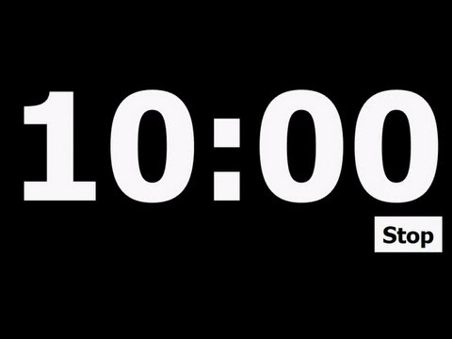
在“6.3的课堂练习”中，添加函数到你的组件来响应（使用alert）不同的鼠标事件
// 1. Alert "prrrr" on onMouseOver
// 2. Alert "Hiss" on onDoubleClick
// 3. Alert 你的信息 on onMouseLeave
// 4. 添加更多的函数
Notes:
Teacher Notes:
Use this time to walk through the code together. Ask questions along the way. Have students type along with you.
https://popcode.org/?snapshot=67d8801c-064c-442c-a308-5d6f5551f5d2

Slide 9
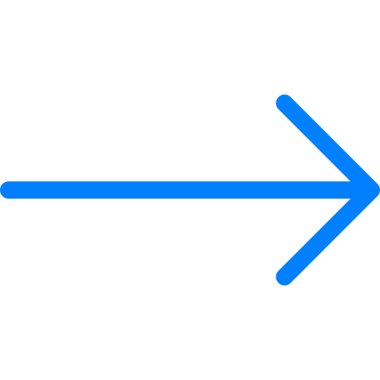
Arrow Function Mini Lesson
Arrow functions provide a shorter way to define a function
function (arg1, arg2, arg3) {
var value = arg1 + arg2 - arg3;
return value;
}
(arg1, arg2, arg3) => {
var value = arg1 + arg2 - arg3;
return value;
}
function (arg1, arg2, arg3) {
return arg1.length;
}
(arg1, arg2, arg3) => arg1.length

Slide 10
Syntax Breakdown
function (arg1, arg2, arg3) {
var value = arg1 + arg2 - arg3;
return value;
}
(arg1, arg2, arg3) => {
var value = arg1 + arg2 - arg3;
return value;
}

Slide 11
Syntax Breakdown
function (arg1, arg2, arg3) {
var value = arg1 + arg2 - arg3;
return value;
}
(arg1, arg2, arg3) => {
var value = arg1 + arg2 - arg3;
return value;
}

Slide 12
Syntax Breakdown
function (arg1, arg2, arg3) {
var value = arg1 + arg2 - arg3;
return value;
}
(arg1, arg2, arg3) => {
var value = arg1 + arg2 - arg3;
return value;
}

Slide 13
Syntax Breakdown
If an arrow function is simply returning a single line of code, you can omit the curly brackets and the return keyword.
function (arg1, arg2, arg3) {
return arg1.length;
}
(arg1, arg2, arg3) => arg1.length

Slide 14
Syntax Breakdown
Name these arrow functions by assigning it to a variable
function myFunc (arg1, arg2, arg3) {
return arg1.length;
}
let myFunc = (arg1, arg2, arg3) => arg1.length

Slide 15
Convert these to arrow functions
https://repl.it/@sayri/Practice-Arrow-Functions
Notes:
https://repl.it/@sayri/Practice-Arrow-Functions

Slide 16
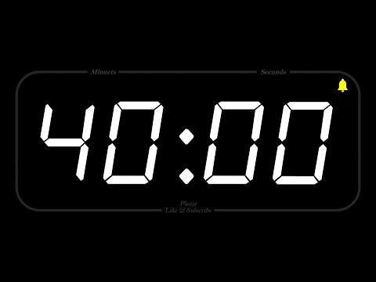
在剩下的40分钟里，你需要完善你的项目：
当用户点击一个问题时，应该alert这个问题
使用任意额外的事件来为你的组件添加样式
Notes:
^{Teacher Notes:}
Leave these up so students can refer back to.

